Slide 1
COMP 2710 Software Construction
Structures and Classes
Constructors
Parameters
Dr. Alvin Lim
Auburn University
http://www.eng.auburn.edu/~lim
limalvi@auburn.edu
Fall 2014
These slides are adapted from notes by Dr. Winard Britt
Notes:
See also Lec05a.ppt in Fall’09

Slide 2
Structures and Classes
Copyright © 2008 Pearson Addison-Wesley. All rights reserved.
6-<number>

Slide 3
Learning Objectives
Structures
  Structure types
  Structures as function arguments
  Initializing structures
Classes
  Defining, member functions
  Public and private members
  Structures vs. classes
Copyright © 2008 Pearson Addison-Wesley. All rights reserved.
6-<number>

Slide 4
Structures
Aggregate data type: struct
Aggregate meaning "grouping"
  Array: collection of values of same type
  Structure: collection of values of different types
Treated as a single item, like arrays
Major difference: Must first "define" struct
  Prior to declaring any variables
Copyright © 2008 Pearson Addison-Wesley. All rights reserved.
6-<number>
Notes:
Student: name, age, gender
Three Steps: (1) Define (2) Declare (3) Use

Slide 5
Structure Types
Define struct globally (typically)
No memory is allocated
  Just a "placeholder" for what our struct
  will "look like"
Definition:
struct CDAccountV1 ←Name of new struct "type"
{
double balance; ← member names
double interestRate;
int term;
};
Copyright © 2008 Pearson Addison-Wesley. All rights reserved.
6-<number>

Slide 6
Declare Structure Variable
With structure type defined, now declare
variables of this new type:
CDAccountV1 account;
  Just like declaring simple types
  Variable account now of type CDAccountV1
  It contains "member values"
    Each of the struct "parts"
Copyright © 2008 Pearson Addison-Wesley. All rights reserved.
6-<number>

Slide 7
Accessing Structure Members
Dot Operator to access members
  account.balance
  account.interestRate
  account.term
Called "member variables"
  The "parts" of the structure variable
  Different structs can have same name
  member variables
    No conflicts
Copyright © 2008 Pearson Addison-Wesley. All rights reserved.
6-<number>

Slide 8
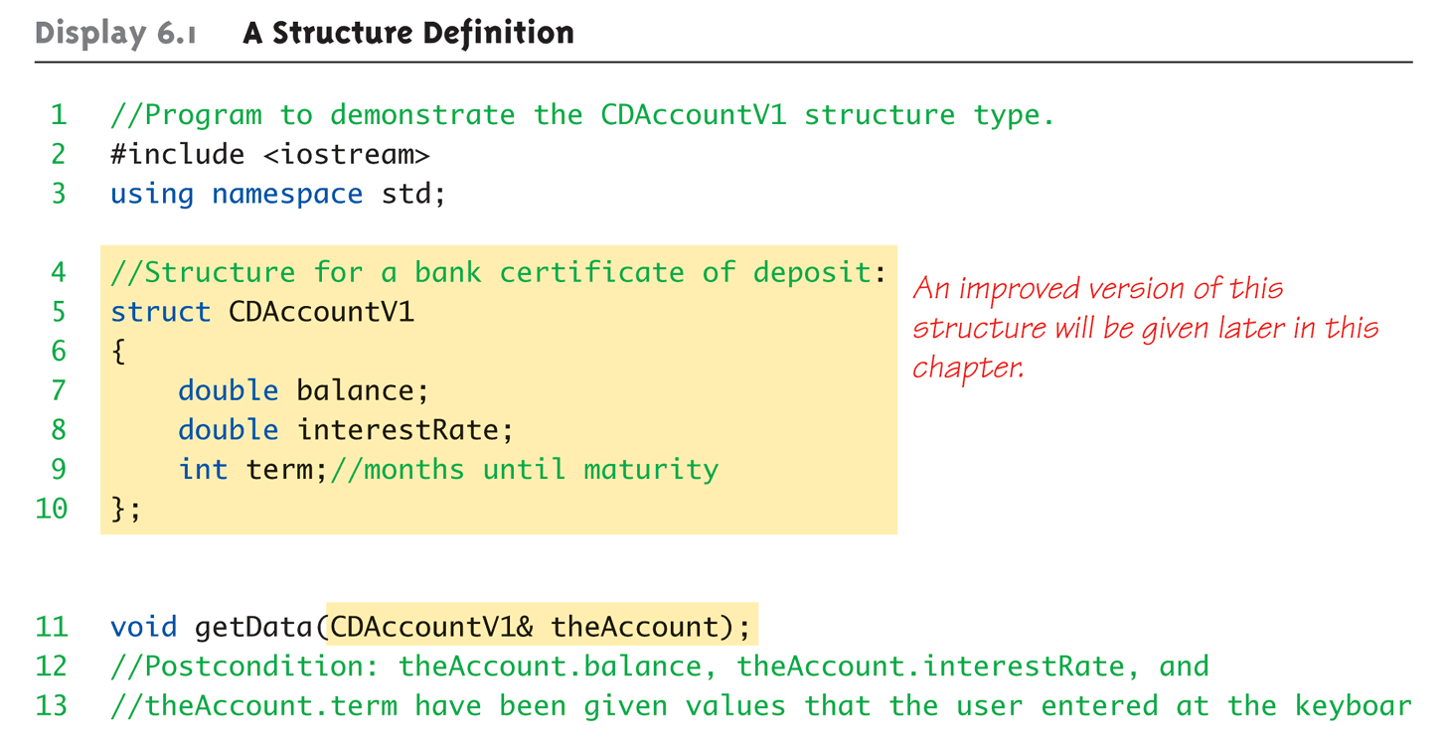
Structure Example:
Display 6.1 A Structure Definition (1 of 3)
Copyright © 2008 Pearson Addison-Wesley. All rights reserved.
6-<number>
Notes:
Original version: Accountv1.cpp
getMyAccount is included in account.cpp

Slide 9
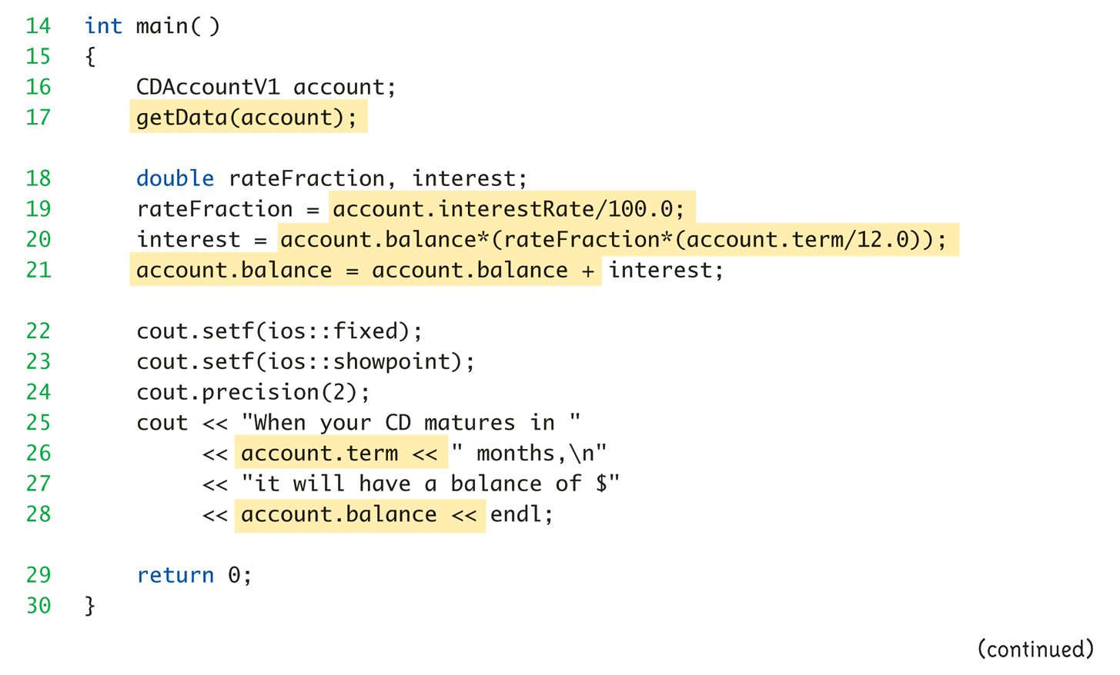
Structure Example:
Display 6.1 A Structure Definition (2 of 3)
Copyright © 2008 Pearson Addison-Wesley. All rights reserved.
6-<number>

Slide 10
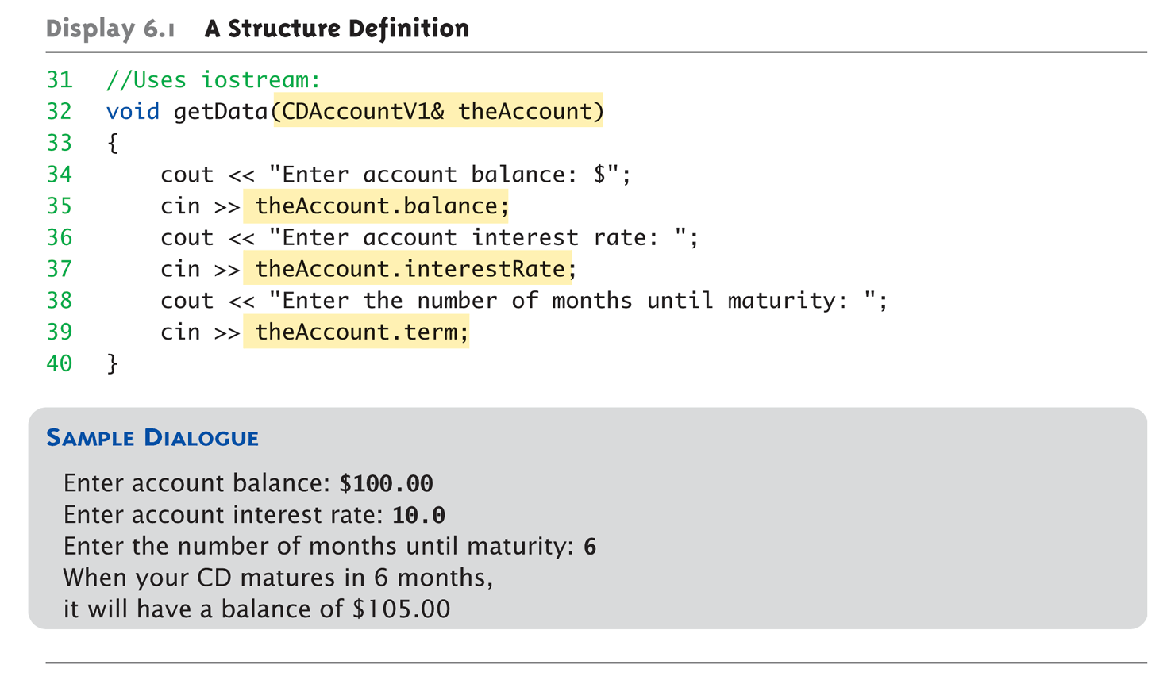
Structure Example:
Display 6.1 A Structure Definition (3 of 3)
Copyright © 2008 Pearson Addison-Wesley. All rights reserved.
6-<number>

Slide 11
Structure Pitfall
Semicolon after structure definition
  ; MUST exist:
  struct WeatherData
  {
  double temperature;
  double windVelocity;
  }; ← REQUIRED semicolon!
  Required since you "can" declare structure
  variables in this location
Copyright © 2008 Pearson Addison-Wesley. All rights reserved.
6-<number>

Slide 12
Structure Assignments
Given structure named CropYield
Declare two structure variables:
CropYield apples, oranges;
  Both are variables of "struct type CropYield"
  Simple assignments are legal:
  apples = oranges;
    Simply copies each member variable from oranges
    into member variables from apples
Copyright © 2008 Pearson Addison-Wesley. All rights reserved.
6-<number>

Slide 13
Structures as Function Arguments
Passed like any simple data type
  Pass-by-value
  Pass-by-reference
  Or combination
Can also be returned by function
  Return-type is structure type
  Return statement in function definition
  sends structure variable back to caller
Can you rewrite the getData() function in Display 6.1 in a way that an account is returned by getData()?
Copyright © 2008 Pearson Addison-Wesley. All rights reserved.
6-<number>

Slide 14
Hierarchical Structures
A member of a structure is a smaller structure
struct Date
{
int month;
int day;
int year;
};
//Improved structure for a bank certificate of deposit:
struct CDAccount
{
double initialBalance;
double interestRate;
int term;//months until maturity
Date maturity; //date when CD matures
double balanceAtMaturity;
};

Slide 15
Access Hierarchical Structures
Two dot operators
cout << "When the CD matured on "
<< account.maturity.month << "-" << account.maturity.day
<< "-" << account.maturity.year << endl
Notes:
See accountv2.cpp

Slide 16
Initializing Structures
Can initialize at declaration
  Example:
  struct Date
  {
  int month;
  int day;
  int year;
  };
  Date dueDate = {12, 31, 2003};
  Declaration provides initial data to all three member variables
Copyright © 2008 Pearson Addison-Wesley. All rights reserved.
6-<number>
Notes:
Define
Declare <- Initialize
Use

Slide 17
Summary
Structure is collection of different types
structure types can be formal parameters to functions
Copyright © 2008 Pearson Addison-Wesley. All rights reserved.
6-<number>

Slide 18
Classes
Copyright © 2008 Pearson Addison-Wesley. All rights reserved.
6-<number>

Slide 19
Classes
Similar to structures
  Adds member FUNCTIONS
  Not just member data
Integral to object-oriented programming
  Focus on objects
    Object: Contains data and operations
    In C++, variables of class type are objects
Copyright © 2008 Pearson Addison-Wesley. All rights reserved.
6-<number>

Slide 20
Class Definitions
Defined similar to structures
Example:
class DayOfYear ← name of new class type
{
public:
void output(); ← member function!
int month;
int day;
};
Notice only member function’s prototype
  Function’s implementation is elsewhere
Copyright © 2008 Pearson Addison-Wesley. All rights reserved.
6-<number>

Slide 21
Declaring Objects
Declared same as all variables
  Predefined types, structure types
Example:
DayOfYear today, birthday;
    Declares two objects of class type DayOfYear
Objects include:
  Data
    Members month, day
  Operations (member functions)
    output()
Copyright © 2008 Pearson Addison-Wesley. All rights reserved.
6-<number>

Slide 22
Class Member Access
Members accessed same as structures
Example:
today.month
today.day
  And to access member function:
  today.output(); ← Invokes member function
Copyright © 2008 Pearson Addison-Wesley. All rights reserved.
6-<number>

Slide 23
Class Member Functions
Must define or "implement" class member
functions
Like other function definitions
  Can be after main() definition
  Must specify class:
  void DayOfYear::output()
  {…}
    :: is scope resolution operator
    Instructs compiler "what class" member is from
    Item before :: called type qualifier
Copyright © 2008 Pearson Addison-Wesley. All rights reserved.
6-<number>

Slide 24
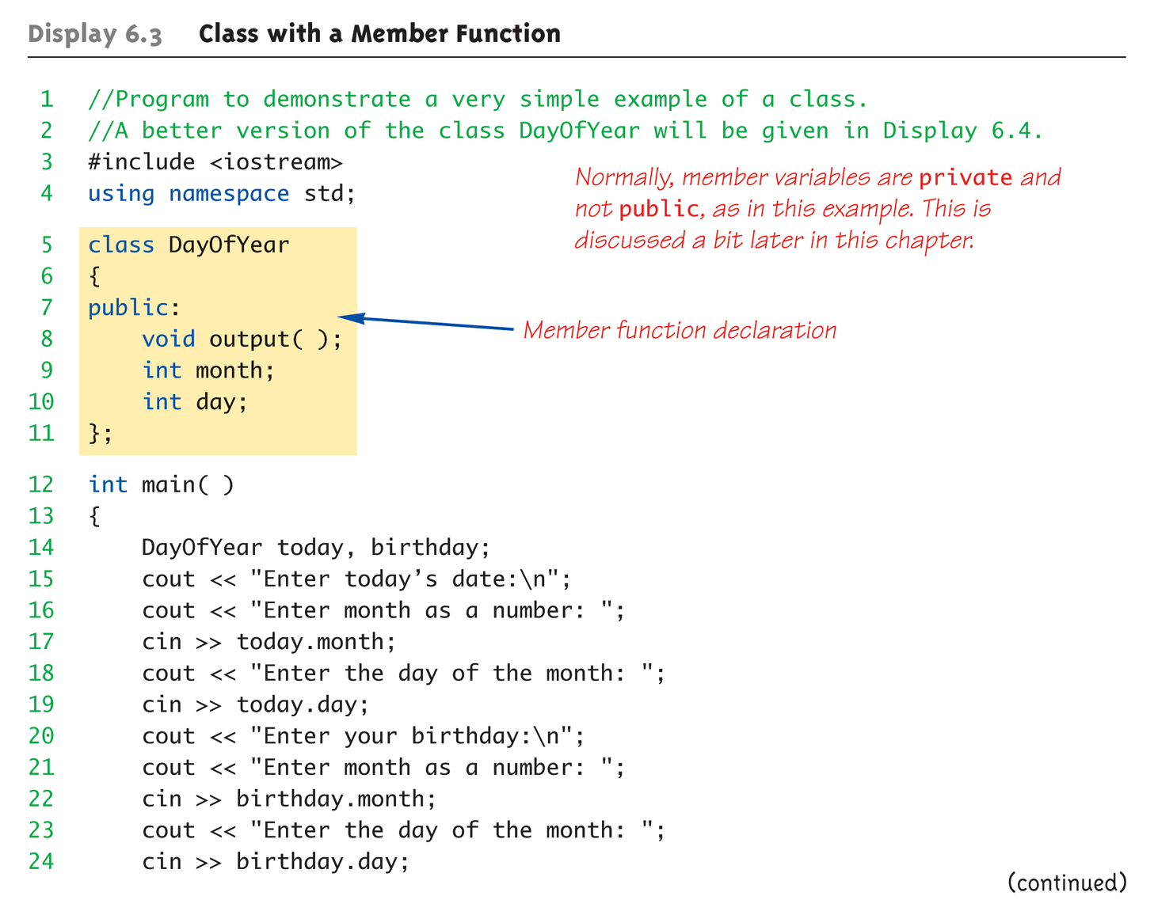
Complete Class Example:
Display 6.3 Class With a Member Function (1 of 4)
Copyright © 2010 Pearson Addison-Wesley. All rights reserved.
6-<number>

Slide 25
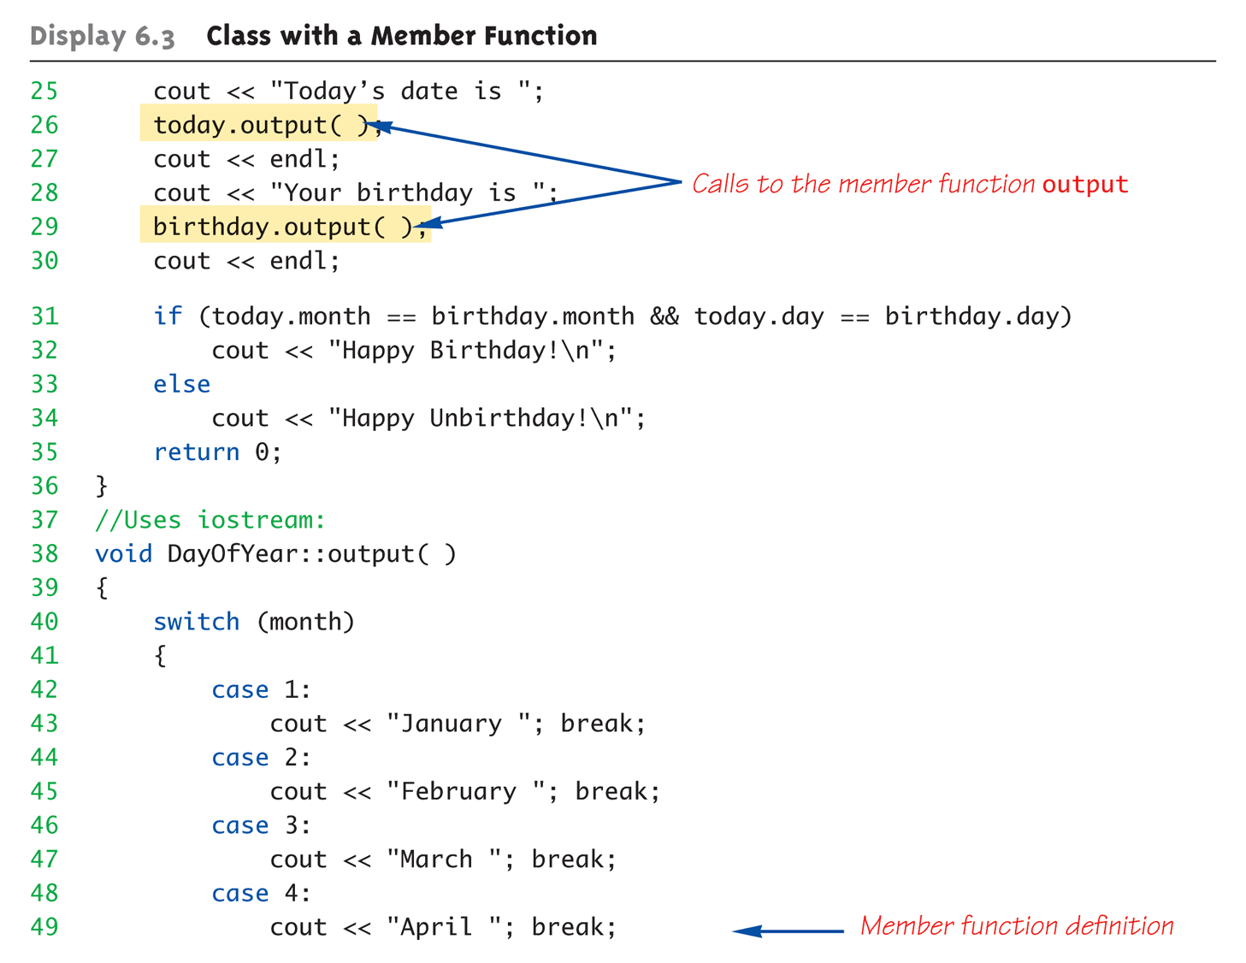
Complete Class Example:
Display 6.3 Class With a Member Function (2 of 4)
Copyright © 2010 Pearson Addison-Wesley. All rights reserved.
6-<number>

Slide 26
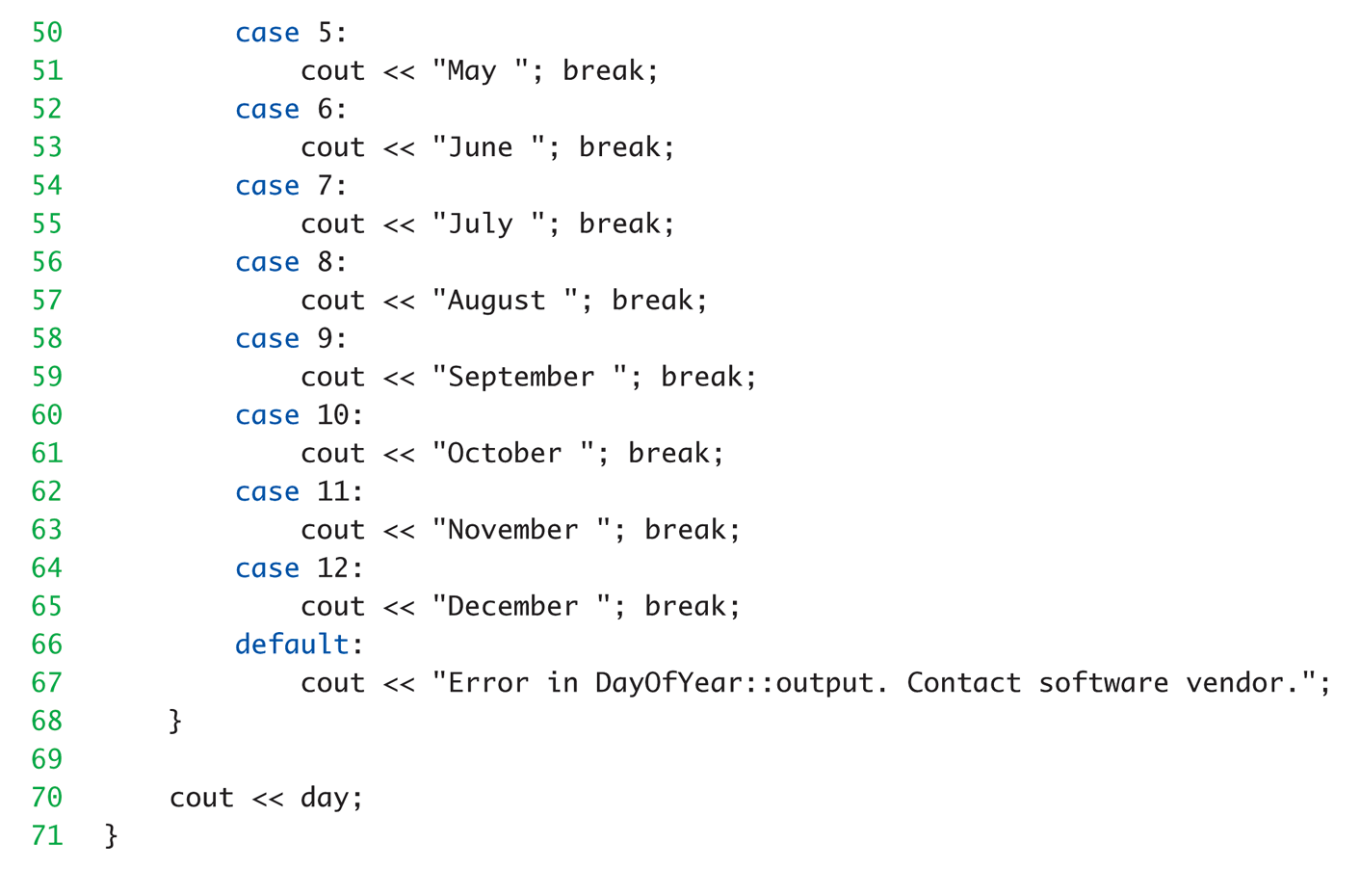
Complete Class Example:
Display 6.3 Class With a Member Function (3 of 4)
Copyright © 2010 Pearson Addison-Wesley. All rights reserved.
6-<number>

Slide 27
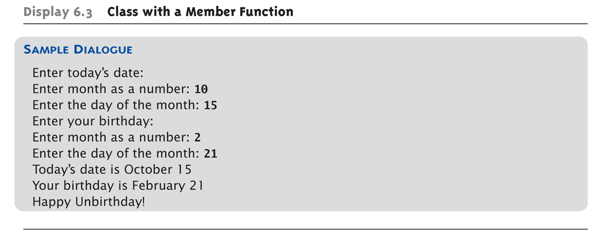
Complete Class Example:
Display 6.3 Class With a Member Function (4 of 4)
Copyright © 2010 Pearson Addison-Wesley. All rights reserved.
6-<number>

Slide 28
A Class’s Place
Class is full-fledged type!
  Just like data types int, double, etc.
Can have variables of a class type
  We simply call them "objects"
Can have parameters of a class type
  Pass-by-value
  Pass-by-reference
Can use class type like any other type!
Copyright © 2010 Pearson Addison-Wesley. All rights reserved.
6-<number>

Slide 29
Encapsulation
Any data type includes
  Data (range of data)
  Operations (that can be performed on data)
Example:
int data type has:
Data: +-32,767
Operations: +,-,*,/,%,logical,etc.
Same with classes
  But WE specify data, and the operations to
  be allowed on our data!
Copyright © 2010 Pearson Addison-Wesley. All rights reserved.
6-<number>

Slide 30
Abstract Data Types
"Abstract"
  Programmers don’t know details
Abbreviated "ADT"
  Collection of data values together with set
  of basic operations defined for the values
ADT’s often "language-independent"
  We implement ADT’s in C++ with classes
    C++ class "defines" the ADT
  Other languages implement ADT’s as well
Copyright © 2010 Pearson Addison-Wesley. All rights reserved.
6-<number>

Slide 31
Object-Based Principles of OOP
Information Hiding
  Details of how operations work not known to "user" of class
Data Abstraction
  Details of how data is manipulated within
  ADT/class not known to user
Encapsulation
  Bring together data and operations, but keep "details" hidden
Copyright © 2010 Pearson Addison-Wesley. All rights reserved.
6-<number>

Slide 32
Public and Private Members
Data in class almost always designated
private in definition!
  Upholds principles of OOP
  Hide data from user
  Allow manipulation only via operations
    Which are member functions
Public items (usually member functions)
are "user-accessible"
Copyright © 2010 Pearson Addison-Wesley. All rights reserved.
6-<number>

Slide 33
Public and Private Example
Modify previous example:
class DayOfYear
{
public:
void input();
void output();
private:
int month;
int day;
};
Data now private
Objects have no direct access
Copyright © 2010 Pearson Addison-Wesley. All rights reserved.
6-<number>

Slide 34
Public and Private Example 2
Given previous example
Declare object:
DayOfYear today;
Object today can ONLY access
public members
  cin >> today.month; // NOT ALLOWED!
  cout << today.day; // NOT ALLOWED!
  Must instead call public operations:
    today.input();
    today.output();
6-<number>

Slide 35
Accessor and Mutator Functions
Object needs to "do something" with its data
Call accessor member functions
  Allow object to read data
  Also called "get member functions"
  Simple retrieval of member data
Mutator member functions
  Allow object to change data
  Manipulated based on application
6-<number>

Slide 36
Separate Interface and Implementation
User of class need not see details of how
class is implemented
  Principle of OOP → encapsulation
User only needs "rules"
  Called "interface" for the class
    In C++ → public member functions declaration and
    associated comments
Implementation of class hidden
  Member function definitions elsewhere
  User need not see them
Copyright © 2010 Pearson Addison-Wesley. All rights reserved.
6-<number>

Slide 37
Summary
Structure is collection of different types
Class used to combine data and functions
into single unit -> object
Member variables and member functions
  Can be public → accessed outside class
  Can be private → accessed only in a member
  function’s definition
Class and structure types can be formal
parameters to functions
Copyright © 2008 Pearson Addison-Wesley. All rights reserved.
6-<number>

Slide 38
Summary 2
C++ class definition
  Should separate two key parts
    Interface: what user needs
    Implementation: details of how class works
Copyright © 2010 Pearson Addison-Wesley. All rights reserved.
6-<number>

Slide 39
Constructors and Other Tools
Copyright © 2008 Pearson Addison-Wesley. All rights reserved.
6-<number>

Slide 40
Constructors
Initialization of objects
  Initialize some or all member variables
  Other actions possible as well
A special kind of member function
  Automatically called when object declared
Very useful tool
  Key principle of OOP
Copyright © 2010 Pearson Addison-Wesley. All rights reserved.
7-<number>

Slide 41
Constructor Definitions
Constructors defined like any
member function
  Except:
    Must have same name as class
    Cannot return a value; not even void!
Copyright © 2010 Pearson Addison-Wesley. All rights reserved.
7-<number>

Slide 42
Constructor Definition Example
Class definition with constructor:
  class DayOfYear
  {
  public:
  DayOfYear(int monthValue, int dayValue);
  //Constructor initializes month & day
  void input();
  void output();
  …
  private:
  int month;
  int day;
  }
Copyright © 2010 Pearson Addison-Wesley. All rights reserved.
7-<number>

Slide 43
Calling Constructors
Declare objects:
DayOfYear date1(7, 4),
date2(5, 5);
Objects are created here
  Constructor is called
  Values in parens passed as arguments
  to constructor
  Member variables month, day initialized:
  date1.month → 7 date2.month → 5
  date1.day → 4 date2.day → 5
Copyright © 2010 Pearson Addison-Wesley. All rights reserved.
7-<number>

Slide 44
Constructor Equivalency
Consider:
  DayOfYear date1, date2
  date1.DayOfYear(7, 4); // ILLEGAL!
  date2.DayOfYear(5, 5); // ILLEGAL!
Seemingly OK…
  CANNOT call constructors like other member functions!
Copyright © 2010 Pearson Addison-Wesley. All rights reserved.
7-<number>

Slide 45
Constructor Code
Constructor definition is like all other
member functions:
DayOfYear::DayOfYear(int monthValue, int dayValue)
{
month = monthValue;
day = dayValue;
}
Note same name around ::
  Clearly identifies a constructor
Note no return type
  Just as in class definition
Copyright © 2010 Pearson Addison-Wesley. All rights reserved.
7-<number>

Slide 46
Alternative Definition
Previous definition equivalent to:
DayOfYear::DayOfYear(int monthValue,
int dayValue)
: month(monthValue), day(dayValue) ←
{…}
Third line called "Initialization Section"
Body left empty
Preferable definition version
Copyright © 2008 Pearson Addison-Wesley. All rights reserved.
7-<number>

Slide 47
Overloaded Constructors
Can overload constructors just like
other functions
Recall: a signature consists of:
  Name of function
  Parameter list
Provide constructors for all possible
argument-lists
  Particularly "how many"
Copyright © 2010 Pearson Addison-Wesley. All rights reserved.
7-<number>

Slide 48
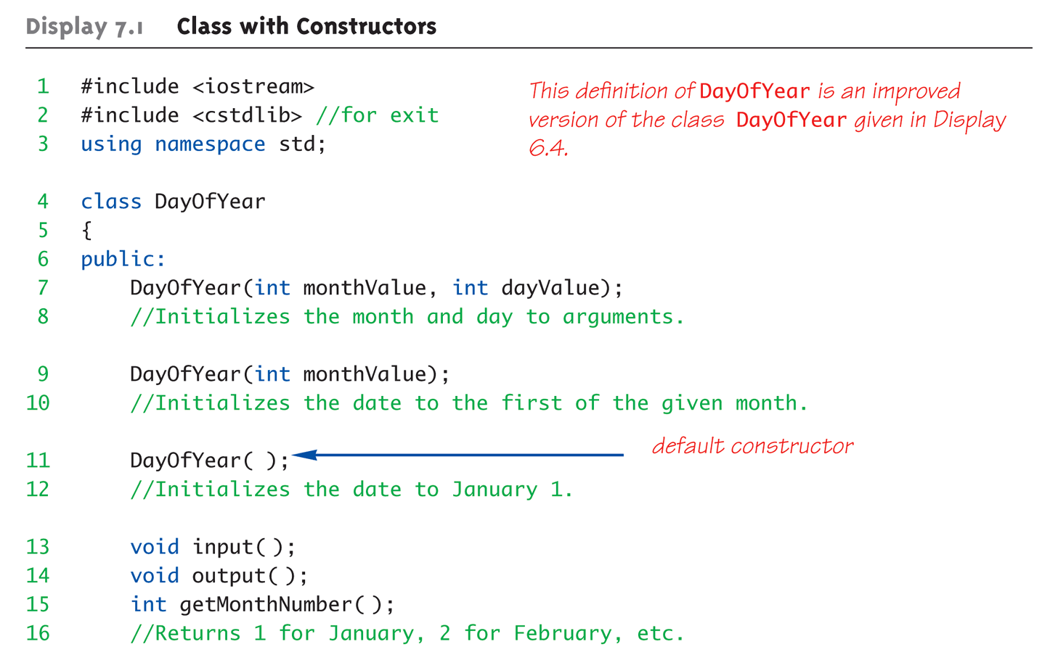
Class with Constructors Example:
Display 7.1 Class with Constructors (1 of 3)
Copyright © 2010 Pearson Addison-Wesley. All rights reserved.
7-<number>

Slide 49
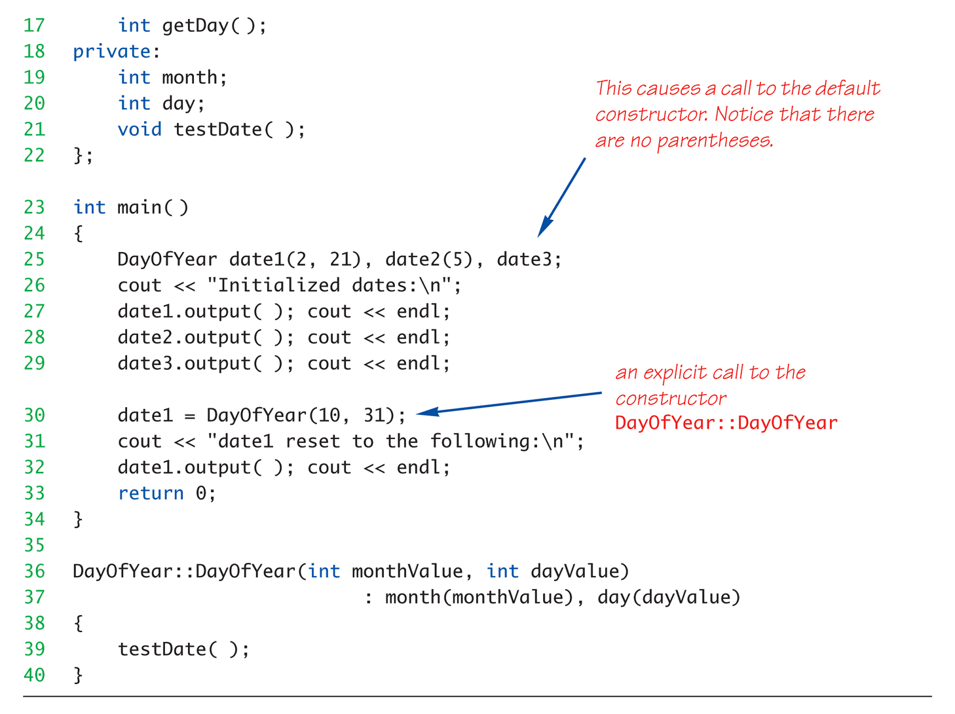
Class with Constructors Example:
Display 7.1 Class with Constructors (2 of 3)
Copyright © 2010 Pearson Addison-Wesley. All rights reserved.
7-<number>

Slide 50
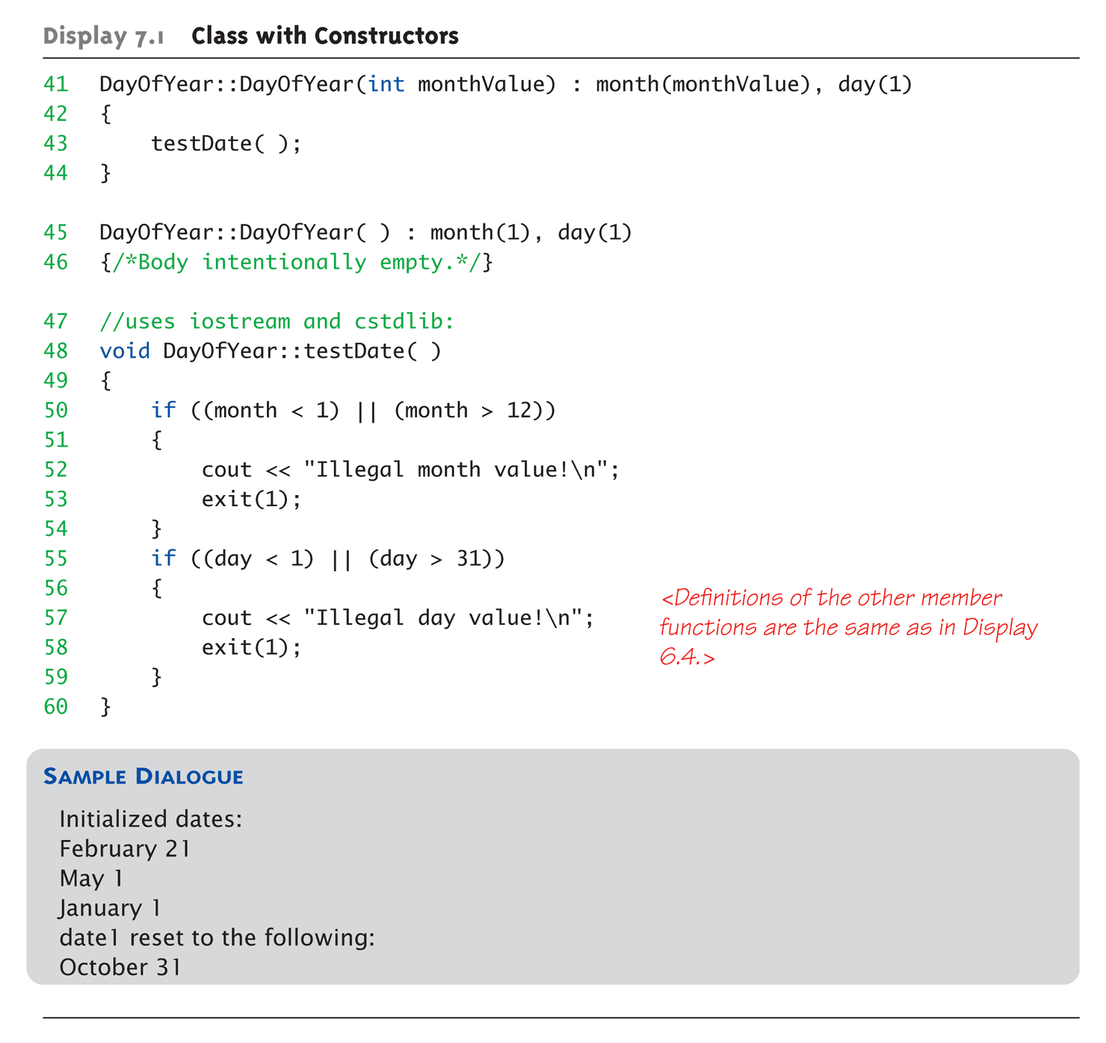
Class with Constructors Example:
Display 7.1 Class with Constructors (3 of 3)
Copyright © 2010 Pearson Addison-Wesley. All rights reserved.
7-<number>

Slide 51
Constructor with No Arguments
Can be confusing
Standard functions with no arguments:
  Called with syntax: callMyFunction();
    Including empty parentheses
Object declarations with no "initializers":
  DayOfYear date1; // This way!
  DayOfYear date(); // NO!
    What is this really?
    Compiler sees a function declaration/prototype!
    Yes! Look closely!
Copyright © 2010 Pearson Addison-Wesley. All rights reserved.
7-<number>

Slide 52
Explicit Constructor Calls
Can also call constructor AGAIN
  After object declared
    Recall: constructor was automatically called then
  Can call via object’s name; standard member
  function call
Convenient method of setting
member variables
Method quite different from standard
member function call
Copyright © 2010 Pearson Addison-Wesley. All rights reserved.
7-<number>

Slide 53
Explicit Constructor Call Example
Such a call returns "anonymous object"
  Which can then be assigned
  In Action:
  DayOfYear holiday(7, 4);
    Constructor called at object’s declaration
    Now to "re-initialize":
    holiday = DayOfYear(5, 5);
      Explicit constructor call
      Returns new "anonymous object"
      Assigned back to current object
Copyright © 2010 Pearson Addison-Wesley. All rights reserved.
7-<number>

Slide 54
Default Constructor
Defined as: constructor w/ no arguments
One should always be defined
Auto-Generated?
  Yes & No
  If no constructors AT ALL are defined → Yes
  If any constructors are defined → No
If no default constructor:
  Cannot declare: MyClass myObject;
    With no initializers
Copyright © 2010 Pearson Addison-Wesley. All rights reserved.
7-<number>

Slide 55
Summary
Constructors: automatic initialization of
class data
  Called when objects are declared
  Constructor has same name as class
Default constructor has no parameters
  Should always be defined
Copyright © 2010 Pearson Addison-Wesley. All rights reserved.
7-<number>

Slide 56
Function Parameters
Copyright © 2008 Pearson Addison-Wesley. All rights reserved.
6-<number>

Slide 57
Parameters
Two methods of passing arguments
as parameters
Call-by-value
  "copy" of value is passed
Call-by-reference
  "address of" actual argument is passed
Copyright © 2010 Pearson Addison-Wesley. All rights reserved.
4-<number>

Slide 58
Call-by-Value Parameters
Copy of actual argument passed
Considered "local variable" inside function
If modified, only "local copy" changes
  Function has no access to "actual argument"
  from caller
This is the default method
  Used in all examples thus far
Copyright © 2010 Pearson Addison-Wesley. All rights reserved.
4-<number>

Slide 59
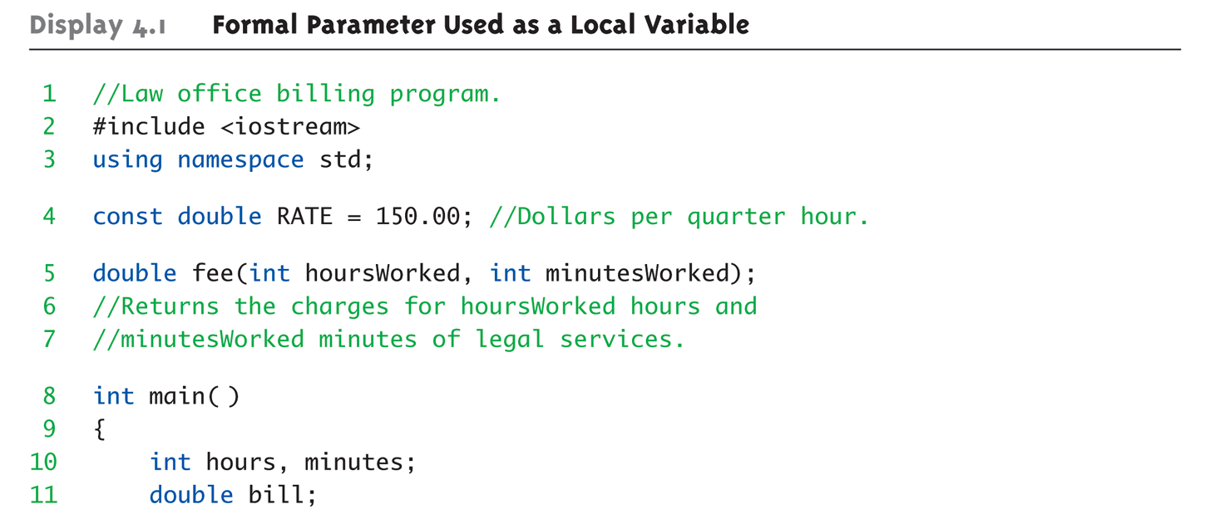
Call-by-Value Example:
Display 4.1 Formal Parameter Used as a Local Variable (1 of 3)
Copyright © 2010 Pearson Addison-Wesley. All rights reserved.
4-<number>

Slide 60
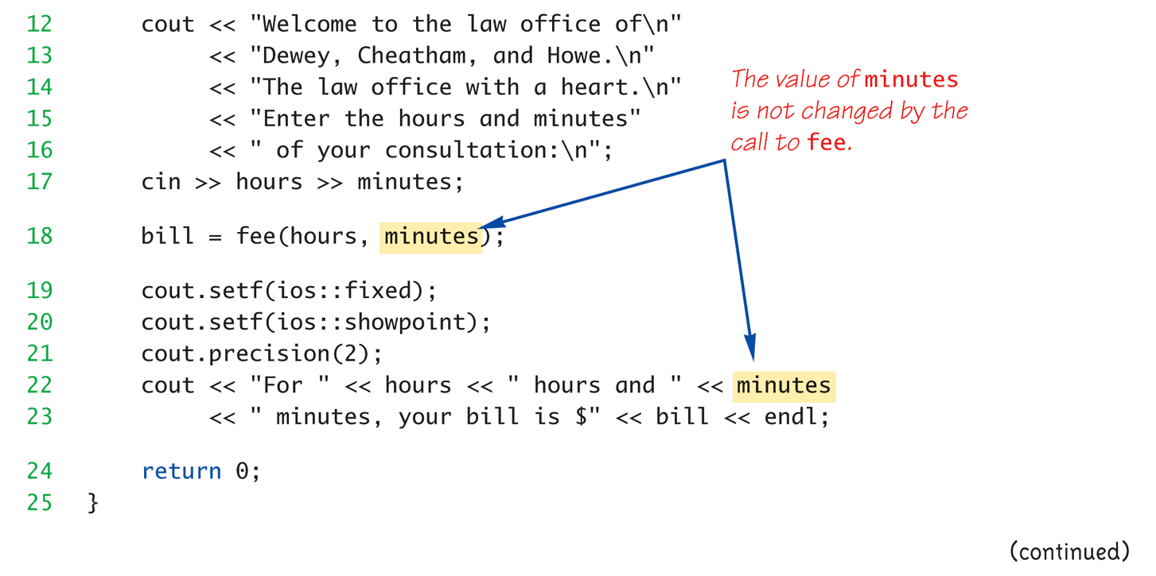
Call-by-Value Example:
Display 4.1 Formal Parameter Used as a Local Variable (2 of 3)
Copyright © 2010 Pearson Addison-Wesley. All rights reserved.
4-<number>

Slide 61
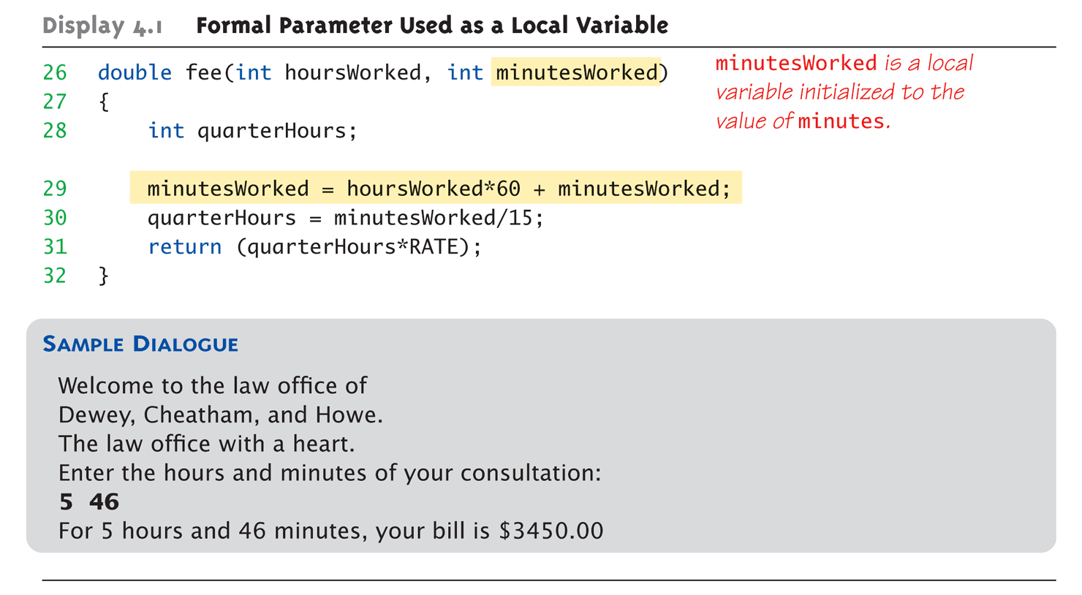
Call-by-Value Example:
Display 4.1 Formal Parameter Used as a Local Variable (3 of 3)
Copyright © 2010 Pearson Addison-Wesley. All rights reserved.
4-<number>

Slide 62
Call-by-Value Pitfall
Common Mistake:
  Declaring parameter "again" inside function:
  double fee(int hoursWorked, int minutesWorked)
  {
  int quarterHours; // local variable
  int minutesWorked // NO!
  }
  Compiler error results
    "Redefinition error…"
Value arguments ARE like "local variables"
  But function gets them "automatically"
Copyright © 2010 Pearson Addison-Wesley. All rights reserved.
4-<number>

Slide 63
Call-By-Reference Parameters
Used to provide access to caller’s
actual argument
Caller’s data can be modified by called function!
Typically used for input function
  To retrieve data for caller
  Data is then "given" to caller
Specified by ampersand, &, after type
in formal parameter list
Copyright © 2010 Pearson Addison-Wesley. All rights reserved.
4-<number>

Slide 64
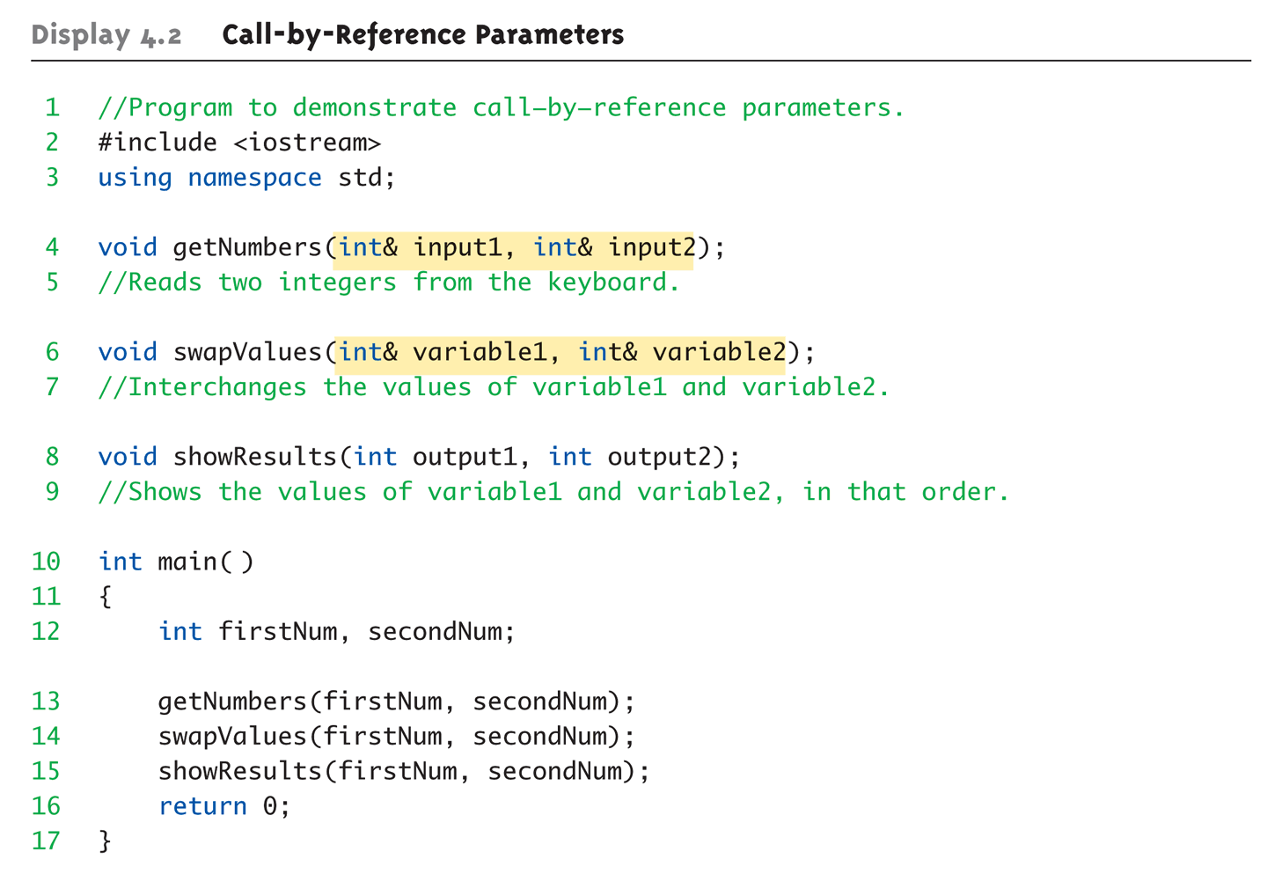
Call-By-Reference Example:
Display 4.1 Call-by-Reference Parameters (1 of 3)
Copyright © 2010 Pearson Addison-Wesley. All rights reserved.
4-<number>

Slide 65
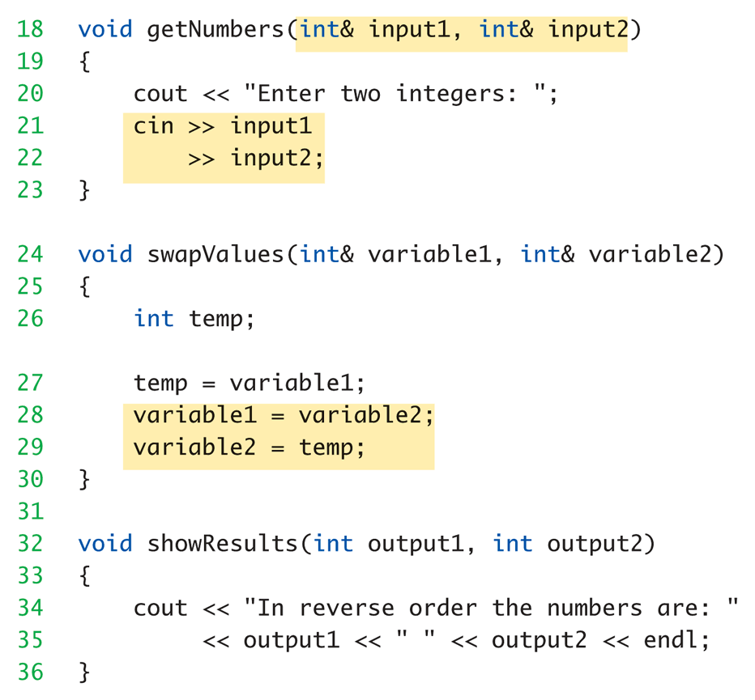
Call-By-Reference Example:
Display 4.1 Call-by-Reference Parameters (2 of 3)
Copyright © 2010 Pearson Addison-Wesley. All rights reserved.
4-<number>

Slide 66
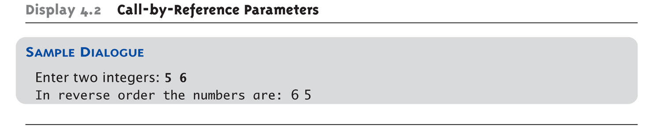
Call-By-Reference Example:
Display 4.1 Call-by-Reference Parameters (3 of 3)
Copyright © 2010 Pearson Addison-Wesley. All rights reserved.
4-<number>

Slide 67
Summary
Formal parameter is placeholder, filled in with actual argument in function call
Call-by-value parameters are "local copies" in receiving function body
  Actual argument cannot be modified
Call-by-reference passes memory address of actual argument
  Actual argument can be modified
  Argument MUST be variable, not constant
Copyright © 2010 Pearson Addison-Wesley. All rights reserved.
4-<number>

